Slide 1
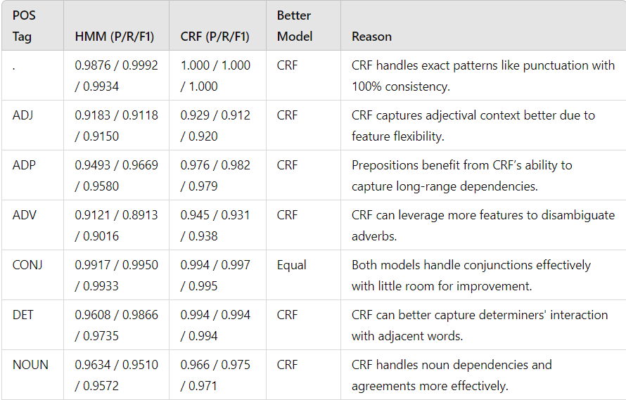
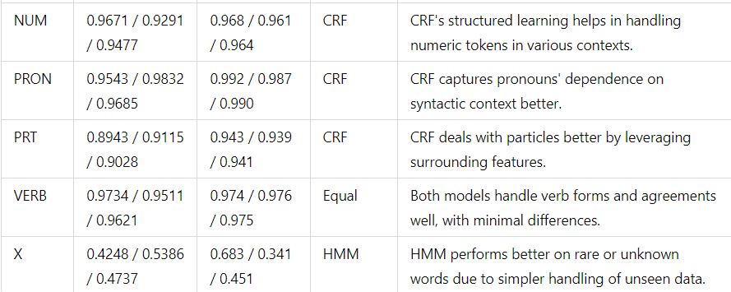
Comparison with HMM

Slide 2
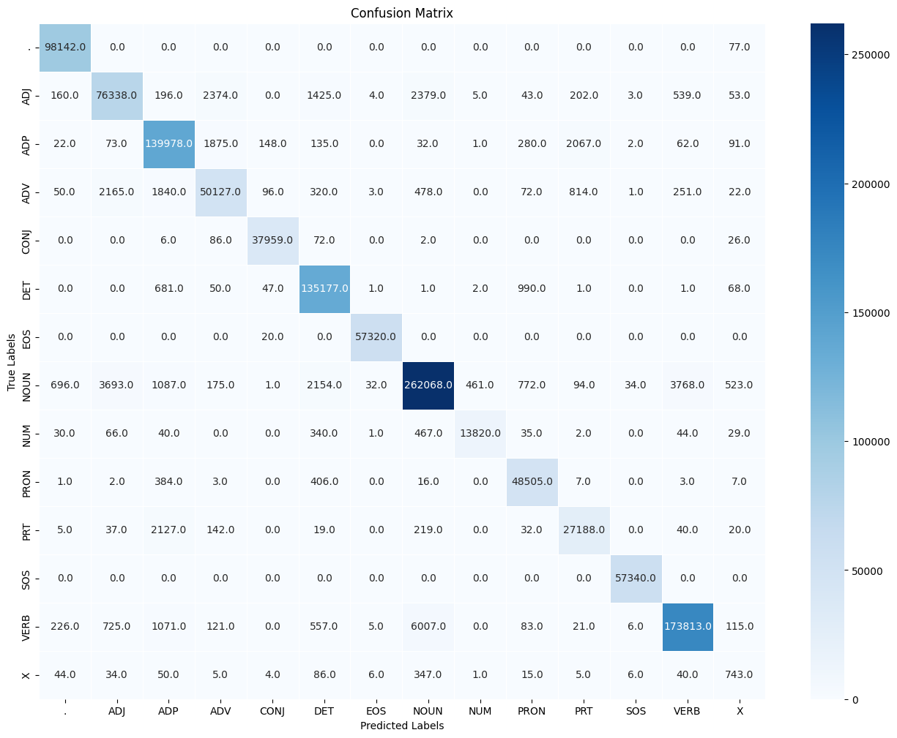
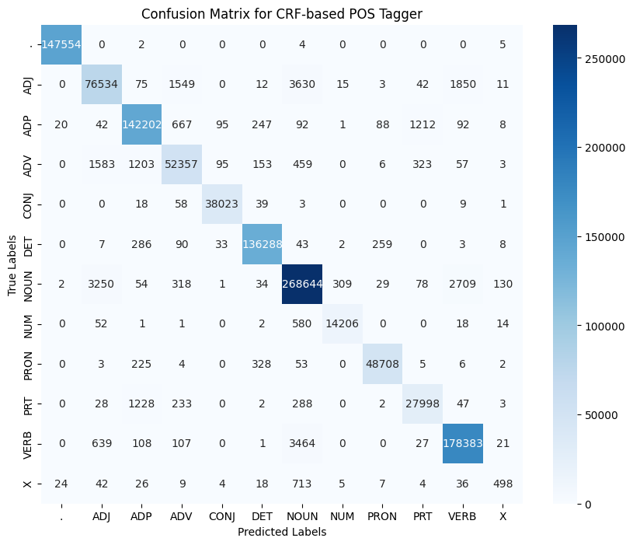
Confusion Matrix
HMM
CRF

Slide 3
Reasons : Comparison with HMM
More Verbs were misclassified in HMM (6007 verbs as nouns) as compared to CRF (3464 nouns as verb) .
Reason: Many words can function as both nouns and verbs depending on context (e.g., "run," "call," "paint"). Example:
"Run" can be a noun ("He went for a run") or a verb ("He will run tomorrow").
"Call" can be a noun ("I received a call") or a verb ("I will call you").
More Adjectives were misclassified as Adverb in HMM (2,374 times a adjective → adverb and 2165 times a adverb → adjective) as compared to CRF( 1549 times a adjective → adverb and 1583 times a adverb → adjective.)
Reason: Adverbs and adjectives can appear close together, often modifying similar types of words (nouns or verbs). For instance, the difference between
"quick" (adjective) and "quickly" (adverb) might not be captured clearly if the model struggles with morphological differences (e.g., "quickly" vs. "quick").
CRF leverages features like word morphology (suffixes like -ly), word order, and dependencies, which aid in reducing the confusion between these two
POS categories
More Particles were misclassified as Adposition in HMM (2,127 times a PRT → ADP and 2067 times a ADP → PRT) as compared to CRF( 1228 times a PRT → ADP and 1212 times a ADP → PRT.)
HMM struggles to distinguish between particles (PRT) and adpositions (ADP) due to their functional overlap (e.g., "up" in "look up" vs. "up the hill"). Its simpler sequential model leads to more misclassification.
CRF performs better by leveraging richer features, like word context and sentence structure, allowing it to differentiate between particles and adpositions more accurately in cases like phrasal verbs versus prepositional phrases.
More X were misclassified in CRF as compare to HMM
Unknown word Handling ( X) was done better in HMM ( Laplace Smoothing) than CRF ( feature of unknown included)
CRF: Utilizes rich feature sets that can capture context better than HMM, making it suitable for disambiguating similar tags.
HMM: Limited to the transitions and emissions learned from the training data, which might not capture the nuances of language well.

